Slide 1
NF Brush Update
Takashi Yokokura
03/17/2022

Slide 2
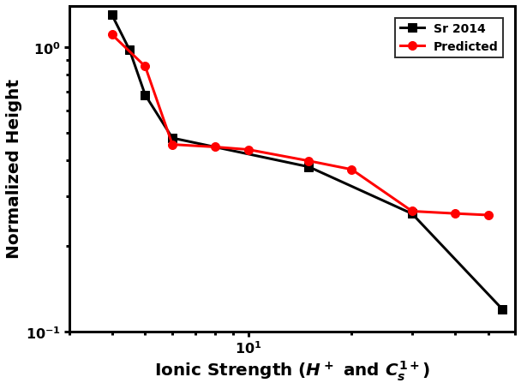
Model parameters
Protein: NF Heavy (NFHSA)
Conditions:
pH = 2.4 (Chosen to match 2014 Srinivasan Nat Comm paper)
Cs = 1 ~ 100 mM
Experimental vs. Predicted Height Profiles (4 mM ~ 40 mM)

Slide 3
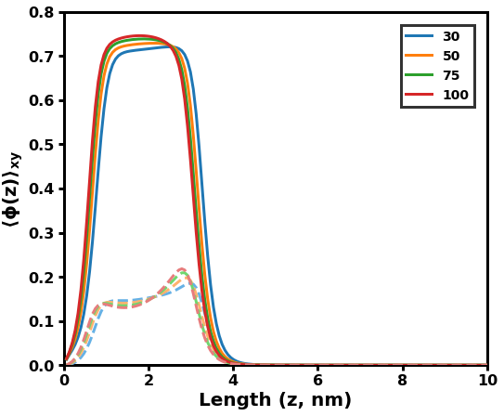
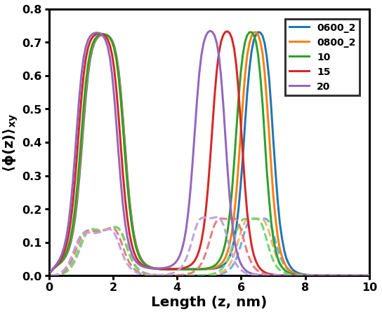
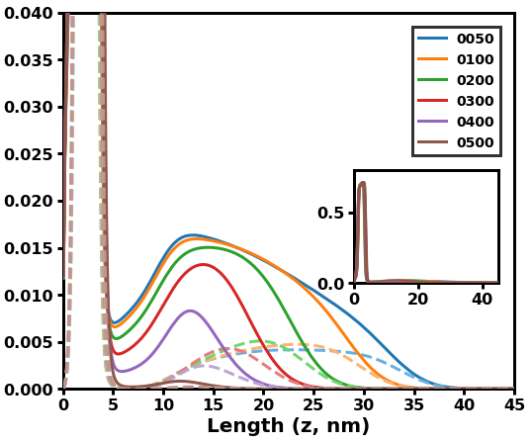
Microphase separation
Pure Collapsed
Melted exterior
Microphase Separation

Slide 4


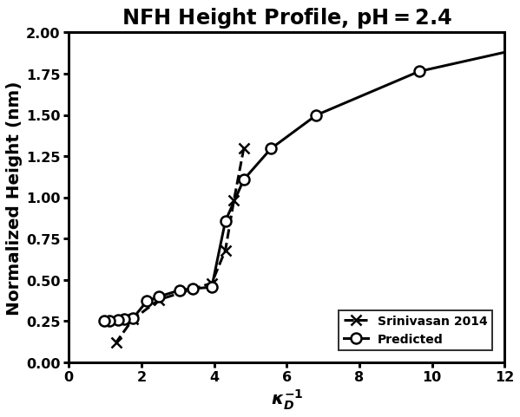
Height vs. Internal Structure
C
B
A
A
B
C

Slide 5
Conclusions
3 structures were present in the predicted results
Condensed and extended conformations
Discrepancy at > 30 mM could be explained by salt displacing enough H+ to change the charge distribution significantly
pH = 2.4 (4 mM): 0.124 → pH = 3.4 (0.4 mM): 0.085
Preliminary experimental results suggests charge distribution as a function of local pH is necessary for a system at bodily conditions (pH = 7.40)

